Slide 1
Writing a java program
Prepared by : ng mee mee

Slide 2
Objectives
Write a java program contain a main method
Only one java file created
Write a java program contain a main method and user-defined methods
Only one java file created
Write a java program contain a main method and user-defined java class.
Two java files need to create for this type application
A java program contain a main method which will called the method defined in another java program. Example, TestRectangle.java
A java program contain a user-defined java class. Example, Rectangle.java

Slide 3
Java program contain a main method
public class hello {
public static void main(String[] args) {
//input statement
//processing statement
//output statement
}
}
File name: hello.java

Slide 4
Sample program
public class CalculatorMain {
public static void main(String[] args) {
double x,y;
x=4.5;
y=3.5;
System.out.println(x+ " - " + y + " = " + (x+y));
System.out.println(x+ " + " + y + " = " + (x-y));
}
}

Slide 5
Java program contain a main method and user-defined methods
public class MethodDemo {
public static void main(String[] args) {
//write your program logic here
}
public static void calculatePay(double hours, double rate){
//write your program logic here
}
}
Main method
User defined method
File name: MethodDemo.java

Slide 6
public class CalculatorMethod {
public static void main(String[] args) {
double x,y,ans;
x=4.5;
y=3.5;
add(x,y);
ans=minus(x,y);
System.out.println(x+ " - " + y + " = " + ans);
}
//the minus method with return value
public static double minus(double a,double b){
double ans;
ans=a-b;
return ans;
}
//the add method with no return value
public static void add(double a,double b){
double sum;
sum=a+b;
System.out.println(a+ " + " + b + " = " + sum);
}
}

Slide 7
Value-returning method (Junior staff)
Write a program that prompts a user to enter a number. The Triple method will receive a number, multiply the number by three and return the result to main() method. The main() method will output the result.
Write a program that prompts a user to enter three numbers. The Average method will receive three numbers, calculates the average of the three numbers and the result return to main() method. The main() method will output the result.

Slide 8
Void method (Senior staff)
Write a program that prompts a user to enter a number. The Triple method will receive a number, multiply the number by three and display the result.
Write a program that prompts a user to enter three numbers. The Average method will receive three numbers, calculates the average of the three numbers and display the result.

Slide 9
Java program contain a main method and user-defined java class
TestRectangle.java contain a main method
public class TestRectangle {
public static void main(String[] args) {
Rectangle r1 = new Rectangle();
System.out.println(“Area:” + r1.getArea());
}
}
Access Rectangle.java through creating Rectangle object named r1. Use object named r1 to call the method getArea()
File name: TestRectangle.java

Slide 10
public class Rectangle {
public Rectangle(){
}
public double getArea(){
}
public double getPerimeter(){
}
}
User defined java class named Rectangle
File name: Rectangle.java

Slide 11
Calculator.java TestCalculator.java
public class Calculator {
private double x;
private double y;
//default constructor
public Calculator() {
x=0;
y=0;
}
//constructor with parameter list
public Calculator(double input1, double input2) {
x=input1;
y=input2;
}
//the add method with no parameter list
public void add(){
System.out.println(x+y);
}
//the add method with a parameter list
public void add(double a,double b){
double sum;
sum=a+b;
System.out.println(sum);
}
}
public class TestCalculator {
public static void main(String[] args) {
Calculator c1 = new Calculator(4.3,5.7);
c1.add();
c1.add(1.5,3.5);
}
}

Slide 12
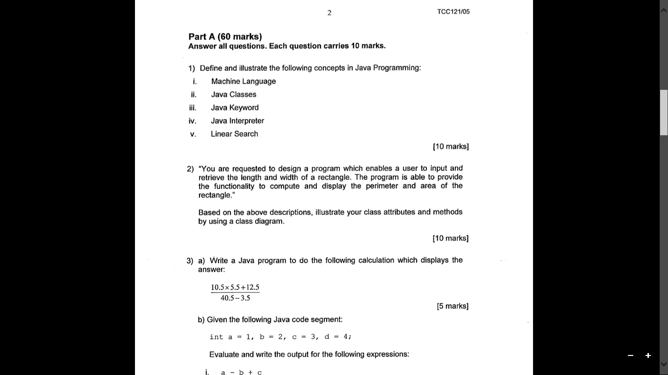
Question

Slide 13
Three basic control structures
Sequence
Selection
Simple if
If..else
Multiple if..else
Switch
Nested if
Conditional operator
Loop
For loop
Do..while loop
While loop

Slide 14
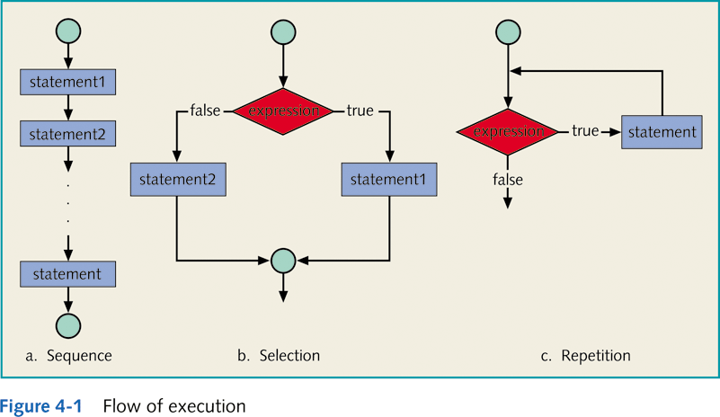
Control Structures

Slide 15
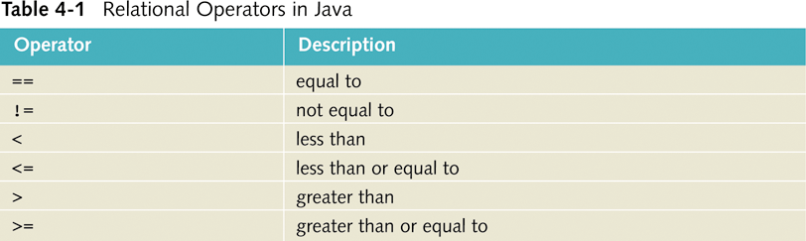
Relational Operators

Slide 16
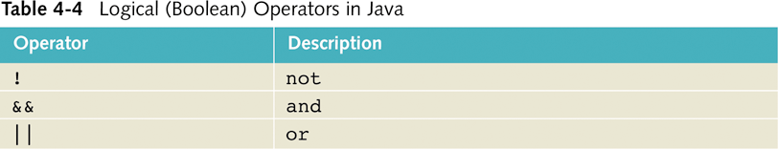
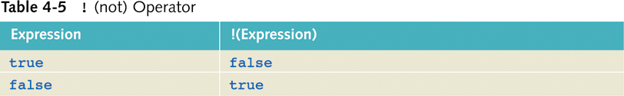
Logical Operators

Slide 17
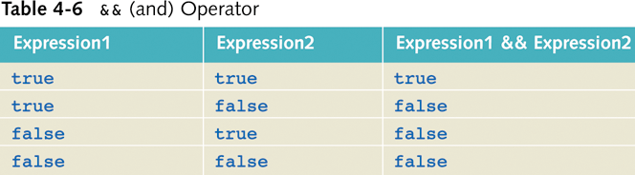
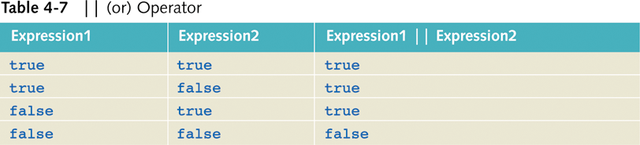

Slide 18
Selection structures
Simple if
If..else
Multiple if..else
Switch
Nested if
Conditional operator

Slide 19
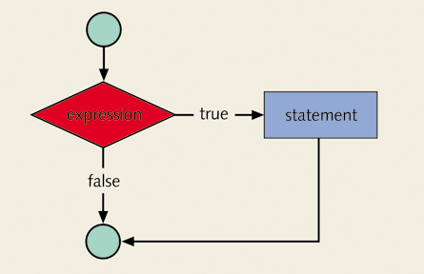
Simple if statement
Syntax:
if (expression)
statement

Slide 20
Expression using greater than relational operator
Example 1:
if (test>60)
System.out.print(“pass”);
Expression using greater than relational operator and AND logical operator
Example 2:
if ((test>60) && (assignment>60))
System.out.print(“pass”);
Expression using greater than relational operator and OR logical operator
Example 3:
if ((test>60) || (assignment>60))
System.out.print(“pass”);

Slide 21
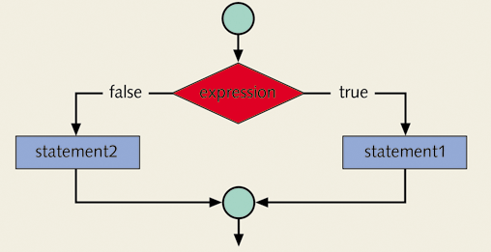
If..else statement
Syntax:
if (expression)
statement1
else
statement2
Example :
if (test > 60)
System.out.print(“pass”);
else
System.out.print(“fail”);

Slide 22
Conditional operator
Syntax:
expression1 ? expression2 : expression3
If expression1 = true, then the result of the condition is expression2.Otherwise, the result of the condition is expression3.
Example 1:
int test = 56;
System.out.print(test > 60 ? "Pass":"Fail");
Output Fail
Example 2:
int test = 76;
System.out.print(test > 60 ? "Pass":"Fail");
Output Pass

Slide 23
Conditional Operator and if..else statement
if (num % 2 == 0)
System.out.println(num + “is even”);
else
System.out.println(num + “is odd”);
System.out.println(
(num % 2 == 0)? num + “is even” :
num + “is odd”);

Slide 24
Switch statement
switch (expression)
{
case value1: statements1
break;
case value2: statements2
break;
...
case valuen: statementsn
break;
default: statements
}
The switch-expression must yield a value of char, byte, short, or int type and must always be enclosed in parentheses.

Slide 25
int month = 8;
switch (month) {
case 1: System.out.println("January"); break;
case 2: System.out.println("February"); break;
case 3: System.out.println("March"); break;
case 4: System.out.println("April"); break;
case 5: System.out.println("May"); break;
case 6: System.out.println("June"); break;
case 7: System.out.println("July"); break;
case 8: System.out.println("August"); break;
case 9: System.out.println("September"); break;
case 10: System.out.println("October"); break;
case 11: System.out.println("November"); break;
case 12: System.out.println("December"); break;
default: System.out.println(“invalid month”);
}
Output August

Slide 26
Multiple if..else statement

Slide 27
Int mark =75;
if ((mark>=80) && (mark <=100)){
System.out.println("A");
}else if((mark>=70) && (mark <=79)){
System.out.println("B");
}else if((mark >=60) && (mark <=69)){
System.out.println("C");
}else if((mark >=50) && (mark <=59)){
System.out.println("D");
}else if((mark>=0) && (mark <=49)){
System.out.println("F");
else{
System.out.println("Invalid mark");
}
Score | Grade
80-100 70-79 60-69 50-59 0-49 | A B C D F
Output B

Slide 28
Nested if statement
Syntax:
if (expression1)
statement1
else
if (expression2)
statement2
else
statement3

Slide 29
Nested if statement – two conditions must be true
Problem: output Pass if both test and assignment are greater than 60
int test=46,assignment=78;
if(test>60){
if(assignment > 60)
System.out.println(“Pass");
else
System.out.println(“fail");
}
else
System.out.println(“fail");
}
Output Fail

Slide 30
Nested if statement – either condition is true
Problem: output Pass if either test or assignment is greater than 60
int test=46,assignment=78;
if(test>60){
System.out.println(“Pass");
}
else
if(assignment > 60)
System.out.println(“Pass");
else
System.out.println(“fail");
}
Output Pass

Slide 31
Question 1
Write a program that asks the user to input a number to determine whether it is odd or even. You should use the modulus operator (%).

Slide 32
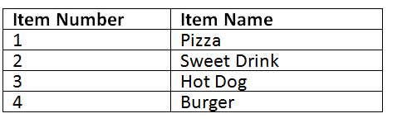
Question 2
Write a program that asks for menu item number 1 to 4 and output the relevant item name based on the following table:
if user input other item number, the program should output “Item is not in menu”.

Slide 33
Question 3
Write a java program that prompts user to input two integers and a number(input 1 to add these two numbers, input 2 to multiply these two numbers). The program will terminate if input other number. Note that two integers must be positive values.

Slide 34
Loop Structures
for loop
do..while loop
while loop
Break statement
Continue statement

Slide 35
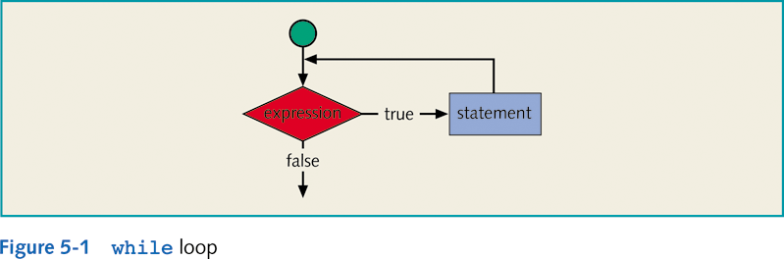
While loop
Syntax:
while (expression)
statement

Slide 36
Example
i = 0; //Line 1
while (i <= 20) //Line 2
{
System.out.print(i + " "); //Line 3
i = i + 5; //Line 4
}
System.out.println(); //Line 5
Output
0 5 10 15 20

Slide 37
Counter-Controlled while Loop
Used when exact number of data or entry pieces is known.
General form:
int N = //value input by user or specified
//in program
int counter = 0;
while (counter < N)
{
.
.
.
counter++;
.
.
.
}

Slide 38
Sentinel-Controlled while Loop
Used when exact number of entry pieces is unknown, but last entry (special/sentinel value) is known.
General form:
Input the first data item into variable;
while (variable != sentinel)
{
.
.
.
input a data item into variable;
.
.
.
}

Slide 39
Example
write a program to enter an integer value, the program exits if the input is 0.
solution 1: do...while loop
-----------------------------
start
do{
get number
}while(number!=0);
stop
solution 2: while loop
---------------------
start
get number
while(number!=0)
get number
end while
Stop

Slide 40
Flag-Controlled while Loop
Boolean value used to control loop.
General form:
boolean found = false;
while (!found)
{
.
.
.
if (expression)
found = true;
.
.
.
}

Slide 41
Example
write a program to enter an integer value, the program exits if the input is 0.
solution 3: while loop with break
---------------------
start
while(true)
get number
if(number==0) break;
end while
Stop

Slide 42
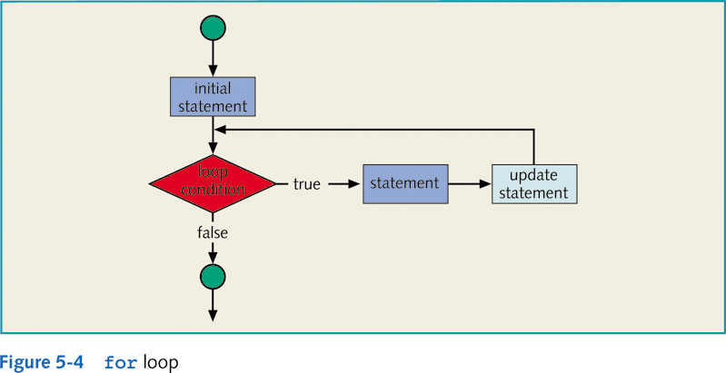
For loop
Syntax:
for (initial statement; loop condition; update statement)
statement

Slide 43
Example
The following for loop prints the first 10 nonnegative integers:
for (i = 0; i < 10; i++)
System.out.print(i + " ");
System.out.println();

Slide 44
Example
The following for loop outputs the word Hello and a star (on separate lines) five times:
for (i = 1; i <= 5; i++)
{
System.out.println("Hello");
System.out.println("*");
}
2. The following for loop outputs the word Hello five times and the star only once:
for (i = 1; i <= 5; i++)
System.out.println("Hello");
System.out.println("*");

Slide 45
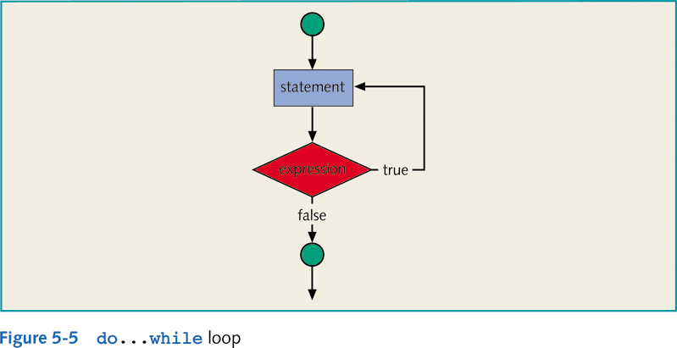
do…while loop
Syntax:
do
statement
while (expression);

Slide 46
break Statements
Used to exit early from a loop.
Used to skip remainder of switch structure.
Can be placed within if statement of a loop.
If condition is met, loop is exited immediately.

Slide 47
Example: break keyword
//add the integers from1 to 20 in this order to sum until sum is //greater than or equal to 100
public class TestBreak{
public static void main(String[] args)
{
int sum=0;
int number=0;
while(number < 20){
number++;
sum+=number;
if(sum>=100)break;
}
System.out.println("The number is " + number);
System.out.println("The sum is " + sum);
}
}
The break statement in the TestBreak program forces the while loop to exit when sum is greater than or equal to 100.

Slide 48
continue Statements
Continue only ends the current iteration.
Program control goes to the end of the loop body.
Generally used with an if statement

Slide 49
Example: Continue Keyword
//add all the integers from 1 to 20 except 10 and 11 to sum
public class TestContinue{
public static void main(String[] args)
{
int sum=0;
int number=0;
while(number < 20){
number++;
if(number ==10 || number ==11)continue;
sum+=number;
}
System.out.println("The sum is " + sum);
}
}

Slide 50
Nested Control Structures
Provides new power, subtlety, and complexity.
if, if…else, and switch structures can be placed within while loops.
for loops can be found within other for loops.

Slide 51
Question 1
Write a java program that ask user to input a score. If score is 5 or 15, then output “Satisfactory!”. If the score is 25, then output “Well done!”. For all other values, output “Goodbye!”. Save the file as Q1a.java and Q1b.java.
a. Use switch statement to write the program
b. Use selection statement to write the program

Slide 52
Question 2
Write a program to determine the English word for numeric value 1 to 5. If the users enter 1, the program will output “One”. The program terminates if 0 is entered. Any other input will display an error message.
Note: use switch or multiple if..else

